Slide 1
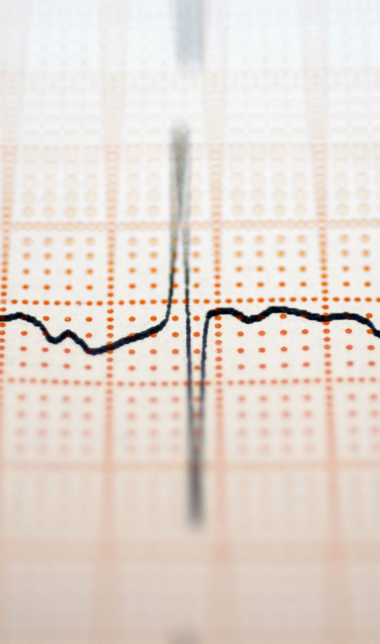
Electroencephalography (EEG) Diagnosis
Mini Project 3

Slide 2
Content
Business Problem
Stakeholder
Data Science Problem
Exploratory Data Analysis
Machine learning process
Conclusion
Future work

Slide 3
Business Problem
Due to rapid increase in Covid-19 cases, most of the manpower in the hospital is allocated to deal with patients with critical conditions.
The job of using EEG scan on patients are assigned to inexperience nurses who are on internship
Most of the interns have difficulty diagnosing the patient’s brain conditions using MRI scan, EEG scan will be easier for them to handle
The EEG diagnosis needs to be fully automated to detect for Seizure and tumor

Slide 4
Stakeholders
Doctors
Electrical Engineers
Neurologists
Hospital CEO
Data Scientists

Slide 5
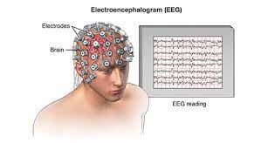
Experiments Conducted
500 individuals had their brain activity recorded
5 different classes:
Seizure
Tumor is near to the EEG scan
Tumor is far from EEG scan
Eyes close
Eyes open

Slide 6
Data Science Problem
Implement a multi-classification machine learning model to determine the conditions of the patients
Class 1:
Seizure
Class 2:
Tumor near
Class 3:
Tumor far
Class 4:
Eye closed
Class 5:
Eye open
Alarm for Seizure activity
Tumor detection
Sleep Disorder

Slide 7
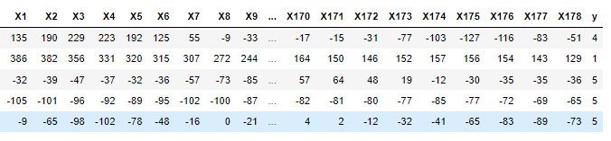
Dataset
X1-X178: time series data
y: class
11,500 rows = 500patients x 23 rows

Slide 8
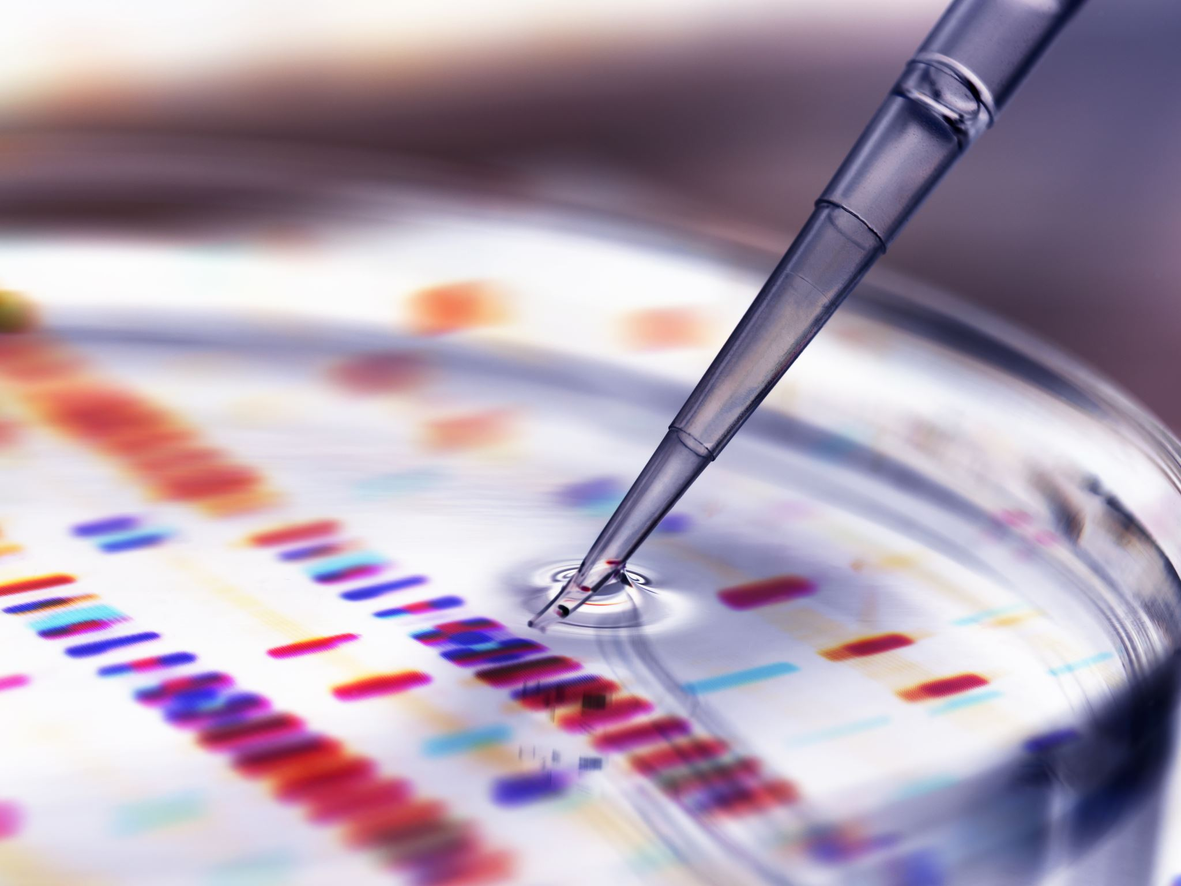
Exploratory data analysis

Slide 9
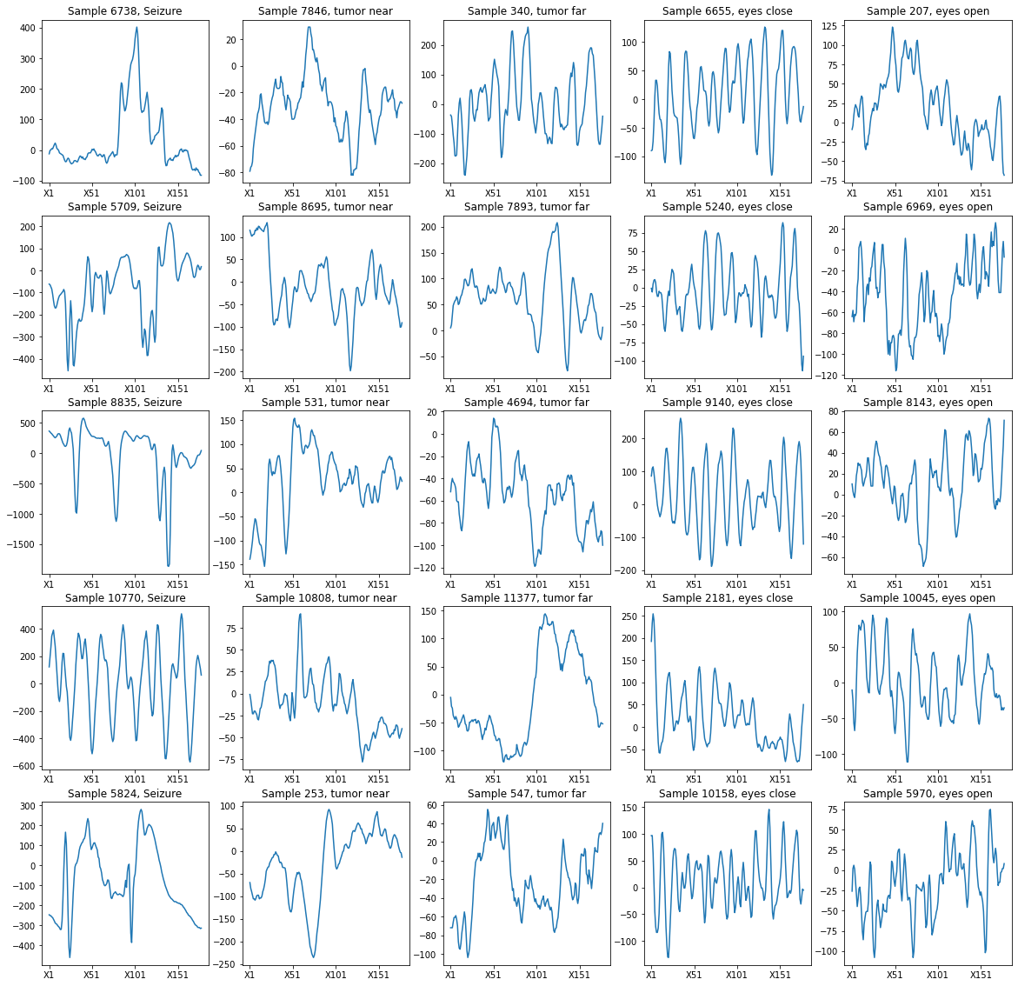
Time series voltage

Slide 10
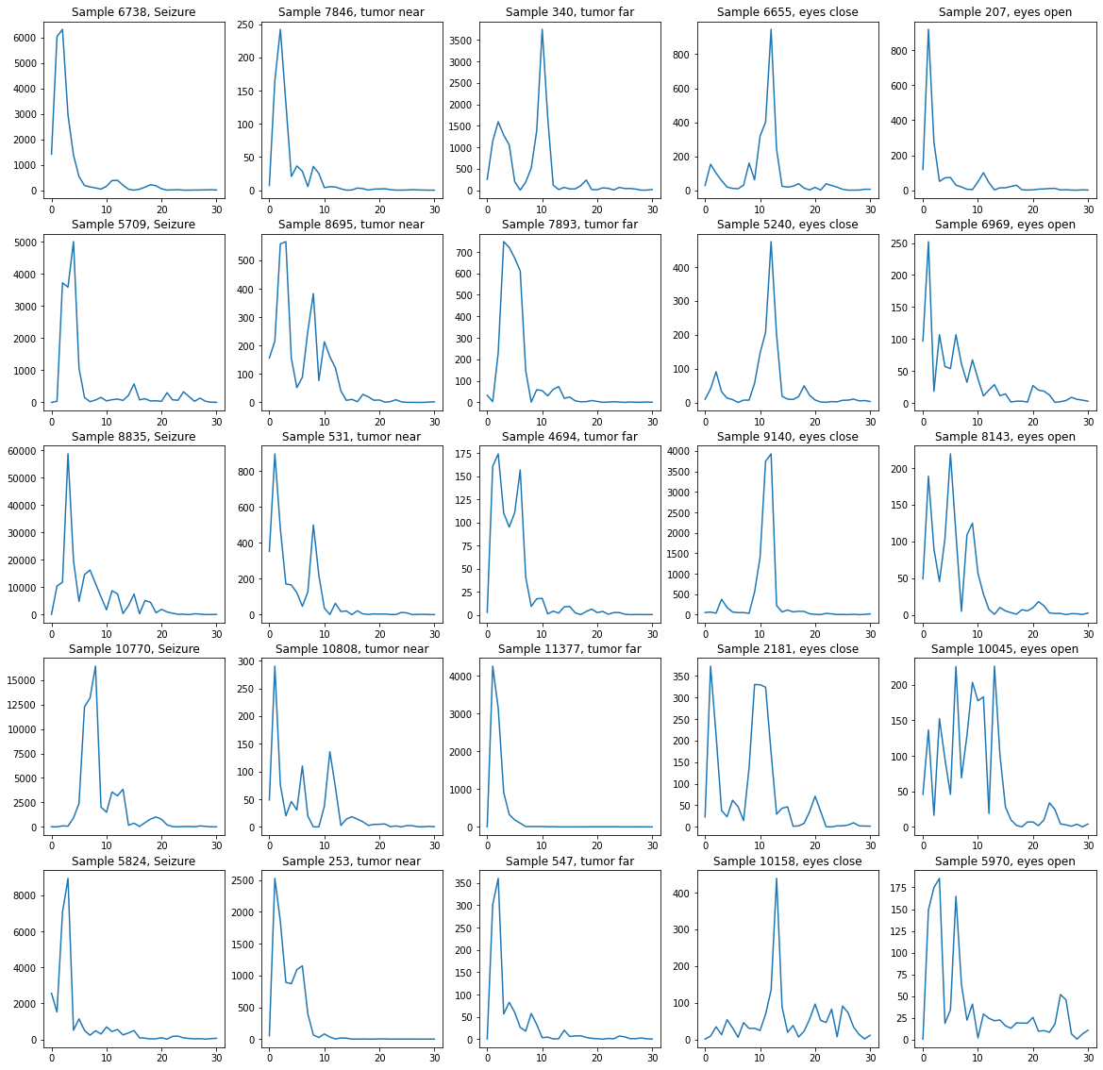
Frequency series power spectral density(psd)
Welch periodogram

Slide 11
Types of brain waves
DELTA WAVES (.5 TO 4 HZ)
deepest meditation and dreamless sleep (Healing and regeneration)
THETA WAVES (3 TO 8 HZ)
learning, memory, and intuition
ALPHA WAVES (8 TO 12 HZ)
mental coordination, calmness, alertness
BETA WAVES (12 TO 30 HZ)
problem solving, judgment, decision making, anxiety

Slide 12
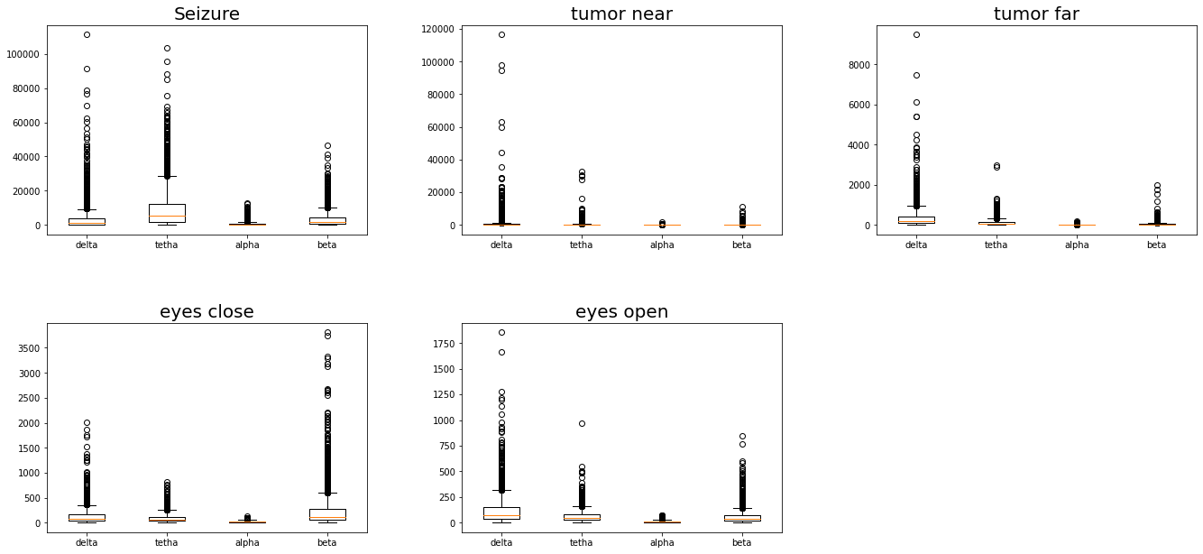

Slide 13
General Observation
Measurements are highly distributed
too many outliers
Extremely difficult to do feature engineering
Due to the complexity of the problem, we decided to use Deep Neutral Network instead

Slide 14
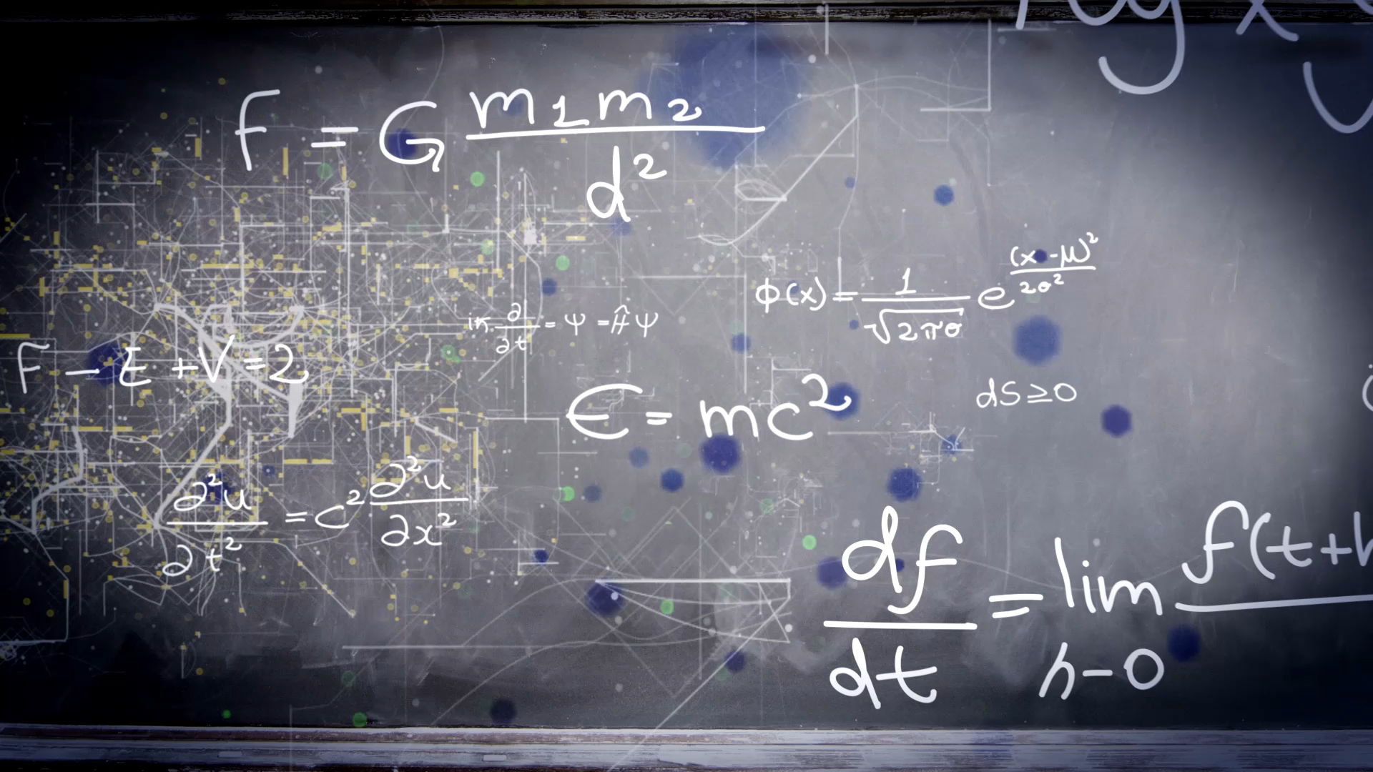
Machine Learning

Slide 15
Long short term memory (LSTM)
Recurrent Neural Networks
Solve the Problem of Long-Term Dependencies of RNN

Slide 16
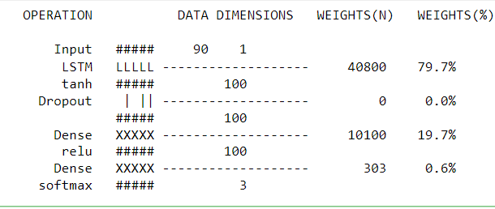
Architecture of LSTM
5

Slide 17
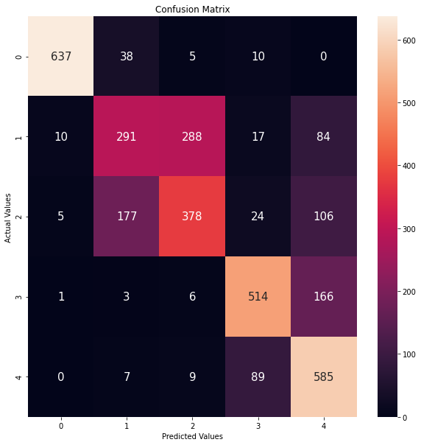
Result of time series
Class 1
Class 1
Class 1
Class 1
Class 2
Class 2
Class 2
Class 2
Accuracy of 69.7%
Class 3
Class 3
Class 3
Actual
Class 4
Class 4
Class 4
Class 5
Class 5
Class 1
Class 2
Class 3
Class 4
Class 5
Predict

Slide 18
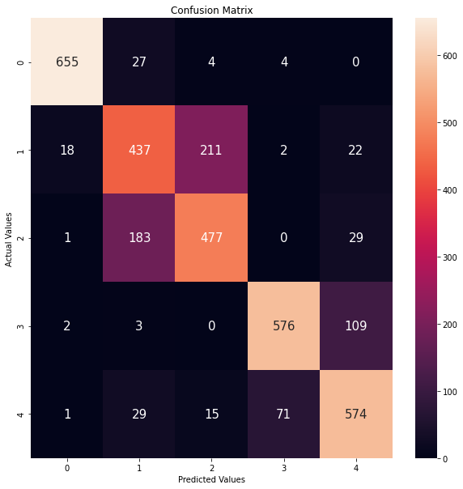
Result of frequency series
Class 1
Class 2
Accuracy of 78.8%
Class 3
Actual
Class 4
Class 5
Class 1
Class 2
Class 3
Class 4
Class 5
Predict

Slide 19
Observation
This model has problem differentiating between Class 2 and 3 (tumor near or far)
Class 1 (seizure) has a precision of 96.8%
Class 4 (eye open) has a precision of 88%
Class 5 (eye close) has a precision of 78%

Slide 20
Modification of objective
EEG will not be used to determine location of tumor
Diagnosis of sleep disorder will be used for another model
Current model will focus solely on:
Seizure detection
Tumor detection (not the location)

Slide 21
3 Classes model
Class 1:
Seizure
Class 2:
Tumor near
Class 3:
Tumor far
Class 4:
Eye closed
Class 5:
Eye open
Class A:
Seizure
Class B:
Tumor
Class C:
Healthy

Slide 22
Architecture of LSTM

Slide 23
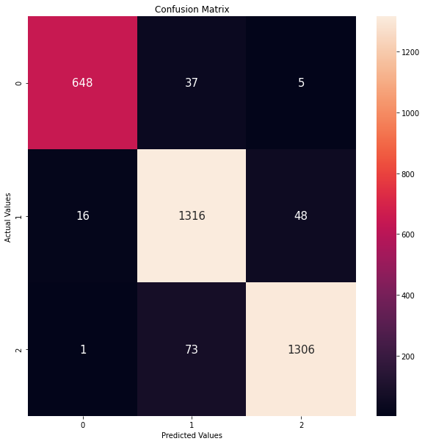
Accuracy improved!
Class A
Overall Accuracy = 94.8%
Seizure
Precision = 97.4%
Recall = 93.9%
Tumor
Precision = 92.3%
Recall = 95.4%
Healthy
Precision = 96.1%
Recall = 94.6%
Class B
Actual
Class C
Class A
Class B
Class C
Predict
Notes:
Hjorth , feature extraction

Slide 24
Conclusion
EEG is not an ideal tool to determine to location of tumor
A separate model will be designed for diagnosis of sleep disorder
Frequency domain data is better than time series
Focus on 3 classes and objectives are seizure and tumor detection

Slide 25
Future Work
Parameter tuning
Adjust the number of layers and neutrons of the model
Explore other models
CNN-LSTM Network Model
ConvLSTM Network Model
Feature engineering
Hjorth parameter
Deploy model to test as trial

Slide 26
Thank you!

